Slide 1
Payroll Certifications
ERS Requirement Workgroup
January 12, 2017
Presenters: David Gracey,
Pauline Librenjak, Bobbi McCracken

Slide 2
Agenda
UCR PAMIS Overview
Payroll Certification
Timeline
Comparison
UCR Metrics
Benefits
Challenges
Demo
Payroll Certification
PIWRS
Central Admin Reports
Questions
Supplemental Resources

Slide 3
Proposal and Award Management
Information System (PAMIS)
PAMIS, an integrated system, facilitated the development of the Payroll Certifications
Proposal
eCAF (Electronic Campus Approval Form)
Pre-Award Request System
Award (eAward)
Notifications
Fund Establishment
Budget Establishment
Monthly PI Web Reporting System (PIWRS)
Annual Payroll Certification System
Expiring Funds Notification System
Notes:
See Process Flow Diagram Handout

Slide 4
UCI-UCR Payroll Certification Pilot Timeline
January 2011 Pilot Proposal Submitted
April 2011 18-Month Pilot Approved
Requirement for two internal audits
October 2012 Pilot extended to 12/31/2013
January 2013 OIG Audit initiated
September 2013 UCR on-site audit by OIG
November 2013 UCR in-person interviews and termination of UCI audit
December 2013 Pilot extended to 3/31/2014
March 2014 Pilot extended to 12/31/2014

Slide 5
UCI-UCR Payroll Certification Pilot Timeline
June 2014 OIG issues UCI’s draft audit
September 2014 OIG conduct UCR’s telephone exit conference
December 2014 OIG issues UCI’s audit
December 2014 Pilot extended to 12/31/2015
December 2015 Pilot extended to 12/31/2016
April 2016 HHS OIG Draft Audit Report issued
June 2016 UCR responded to draft audit
As of 1/12/17, no further communication with HHS- OIG and UCR is awaiting issuance of final report

Slide 6
Effort Report to Payroll Certification Comparison
Description | Effort Reporting System | Payroll Certification System
System Focus | Individuals | Project (Grant or Contract)
Certification Frequency | Quarterly | Annually (Based on project’s budget year)
Time frame for distributing the form | February, May, August, and November | After the end of the project’s budget year
Time frame to sign certification | Within 90 days after the end of the quarter, which is also 45 days after receiving the form | Within 60 days of the end of the budget year.
Certification | Individual employee, Principal Investigator, or person with First-hand knowledge | Required: Principal Investigator Optional: Co-principal Investigator, business officer, lab supervisor, etc.

Slide 7
Effort Report to Payroll Certification Comparison
Description | Effort Reporting System | Payroll Certification System
System Rationale (Theoretical foundation) For Certifying Salaries and Wages | Amounts are reasonable based on percentage of effort | Amounts are reasonable based on work performed
Committed Salary Cost Sharing | Shown as a percentage of effort | Amounts are reasonable based on work performed
NIH Salary Cap | Shows total effort expended on the project, but amount reflects cap limitations | The acceptable amount is net of the cap disallowance.
Special Costing Requirements: Clerical and Administrative, NSF salary limit, No proposal preparation charged to project, NIH cap | Not addressed | Part of the certification
Notes:
.

Slide 8
UCR Metrics
Payroll Certifications Issued between April 2011 and November 2016: 4,357
Payroll Certifications Certified as of 1/8/17: 4,355
Payroll Certifications Completed by due date: 97%
Salaries transferred due to non-certification as allowed by local policy: 0%
Effort Reports that would have been issued between April 2011 and September 2016: 24,875

Slide 9
Benefits of Payroll Certifications
Reporting better aligned with project year and award budget
Complements the PIWRS Monthly Reporting
Late adjustments automatically picked up in the next budget year reporting; resulting in fewer revisions
Distribution of workload over 12 months
Automated notifications and reminders
Consolidation of information to be certified
Less administratively burdensome for Pis (i.e. one approval for everyone paid on an award)

Slide 10
Challenges of Payroll Certifications
Needed to incorporate budget year into our financial system
Shared C&G funds, requires departments to coordinate
Awards and extensions received after expiration date
Problematic moving salaries to an expired award, particularly if over 120 days
Business rules related to final budget year
Departments not utilizing pre-award process
Departments not adequately utilizing comments to explain cost notes

Slide 11
UCR PRC General Timeline
Automated e-mails:
Department coordinator notified immediately after budget year ends to begin validating salary data and gathering cost sharing information
On the 8th of each month, PRC generated and made available for department coordinator’s review prior to distribution to PI
On the 15th of each month, PRC distributed to PI requesting certification within 21 days
On the 28th of each month, reminder notices sent to PI and department coordinator on uncertified funds
Manual e-mails on fund uncertified by due date
Reminder notice copies the department chair
Final notice to college/org requesting FAU to transfer salaries

Slide 12
PRC Demo
Notes:
Pre-defined fund attributes
PRCTest---22347 Balandin
Cost Notes
Direct Cost Salary Adjustment
Drill downs
Support site
Admin Reports???

Slide 13
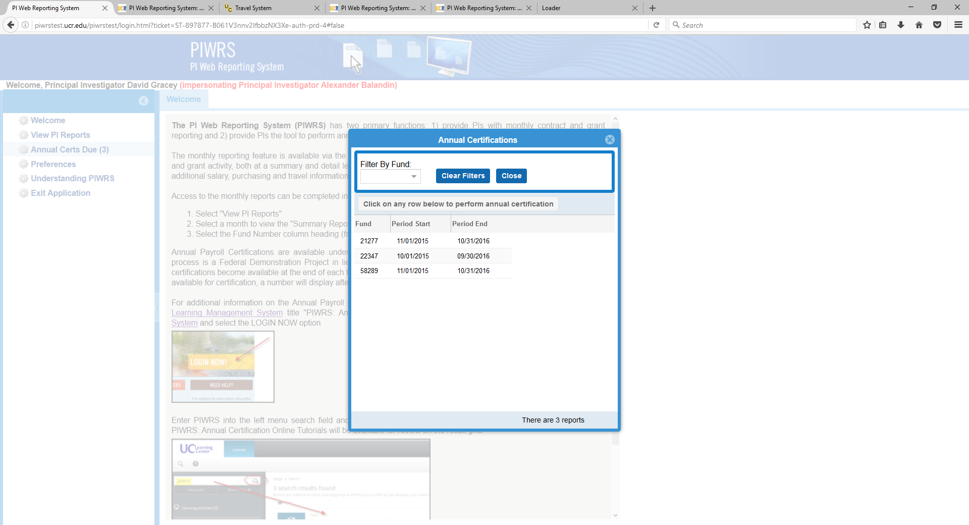
Notes:
Please note this is a test environment. When the PI access UCR’s Proposal and Award Management Information System (PAMIS) portal, one of the links a PI is automatically presented with is our Principal Investigator Web Reporting System/Payroll Certification System. This portal provides monthly expenditure/balance information to the PI on all funds where the individual is the prime PI as well as the complementary Annual Payroll Certification report. To access the Annual Payroll Certifications due, the PI clicks on “Annual Certs Due” and is presented with all funds requiring certification. For this demo, fund 22347 will be used.

Slide 14
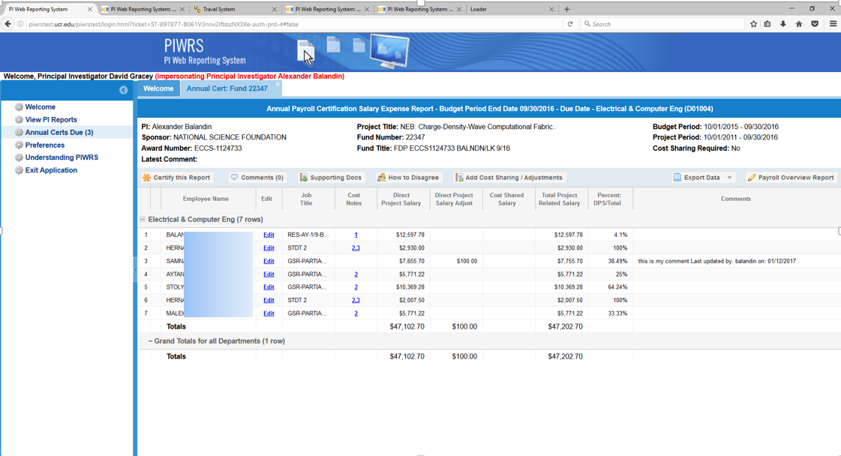
Notes:
This report is landing page for the PI prior to performing the payroll certification. Information on the award’s details (e.g. agency, award number, project title, certification period) are included in the header and a listing of all employees paid on the award during the budget period in the body of this report. Adjustment can be made to the information by clicking on the “Edit” link (see next page); any adjustments noted will appear under the “Direct Project Salary Adjust” column. The “Cost Note” column flags potential audit concerns; the department analyst are tasked with reviewing these potential issues and providing comments to the PI to assist with their confirmation of salary charges; these cost notes will be included in the statement that the PI actually certifies to assure compliance with costing policy. The PI has the ability to drill into additional payroll details by clicking on the “Payroll Overview Report” link. Note the “Percent DPS/Total” is NOT an effort percent, but rather an indicator of the percent of the employee’s salary for the certification period charged to this fund over the employee entire salary charged to all funds for the certification period; this information is intended to assist the PI in evaluating the reasonableness of the salary charge to the fund being certified.

Slide 15
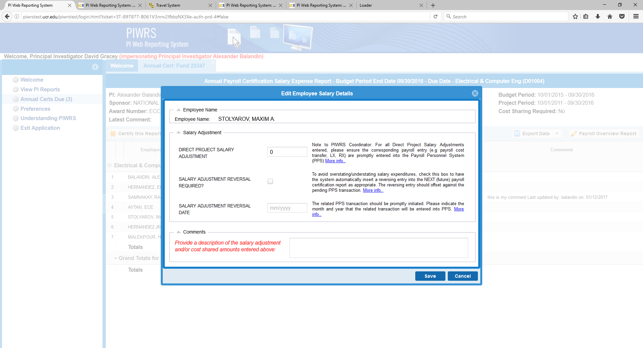
Notes:
The system allows for pending adjustments to be entered into the system (aka Direct Project Salary Adjustments); this feature allows certifications to proceed without waiting for the next month’s PPS journal/DOPE.

Slide 16
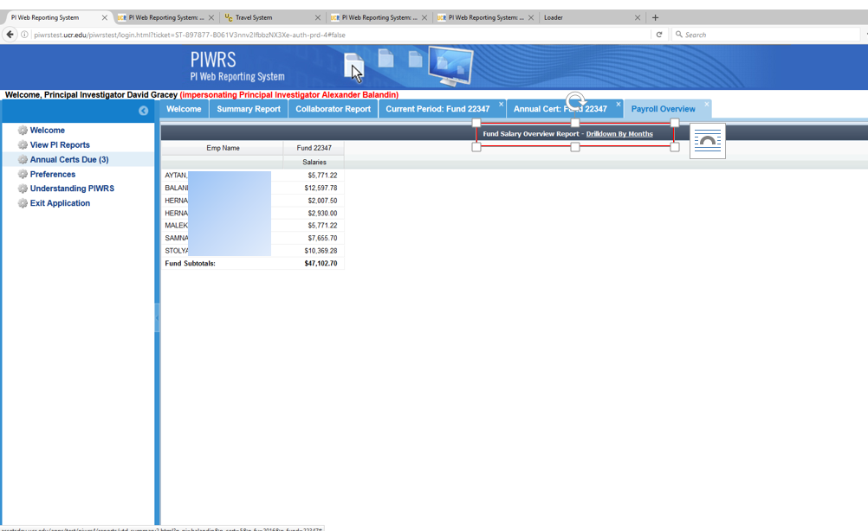
Notes:
This is a summary view of all employees paid on the fund for the certification period; additional details can be viewed by clicking on the Drilldown By Months link—see next screenshot for drilldown information.

Slide 17
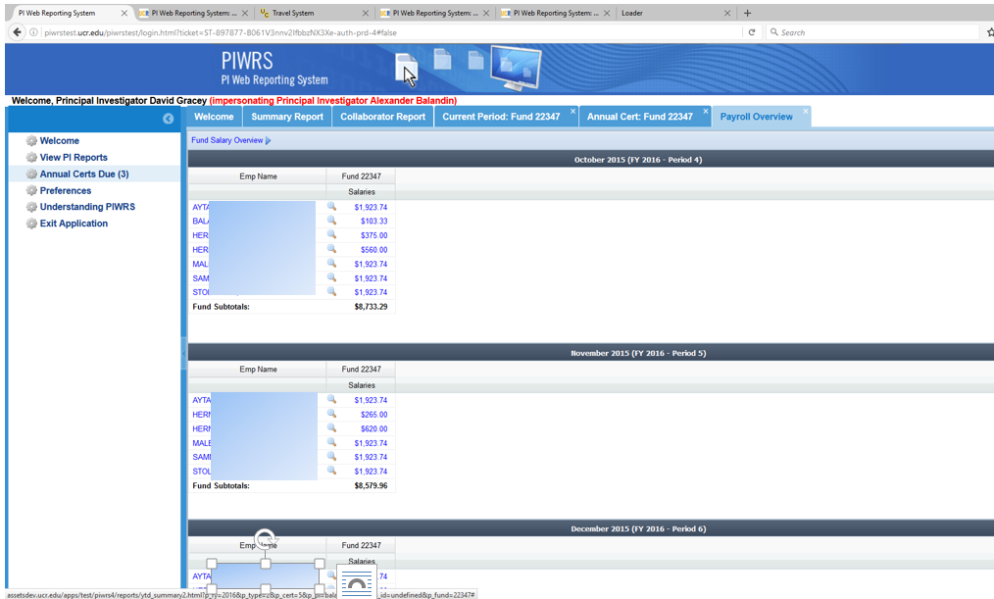
Notes:
This is an overview of all employees paid from the fund for each month of the certification period. The PI has the ability to drill into additional details for an individual employee by clinking on their name—see next screenshot.

Slide 18
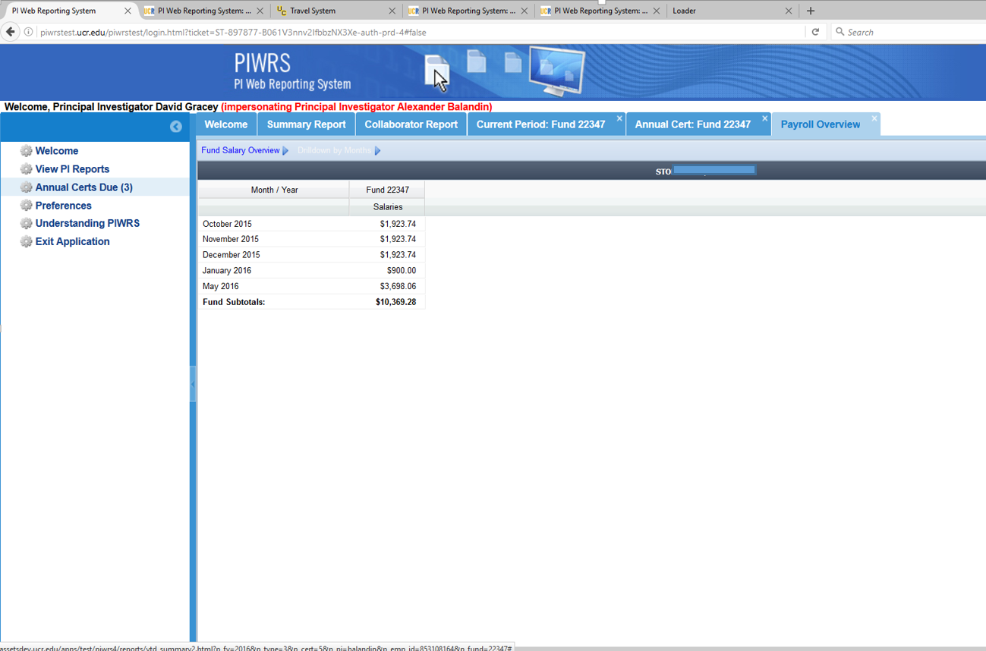
Notes:
This an overview of an individual employee’s monthly pay against the fund to be certified

Slide 19
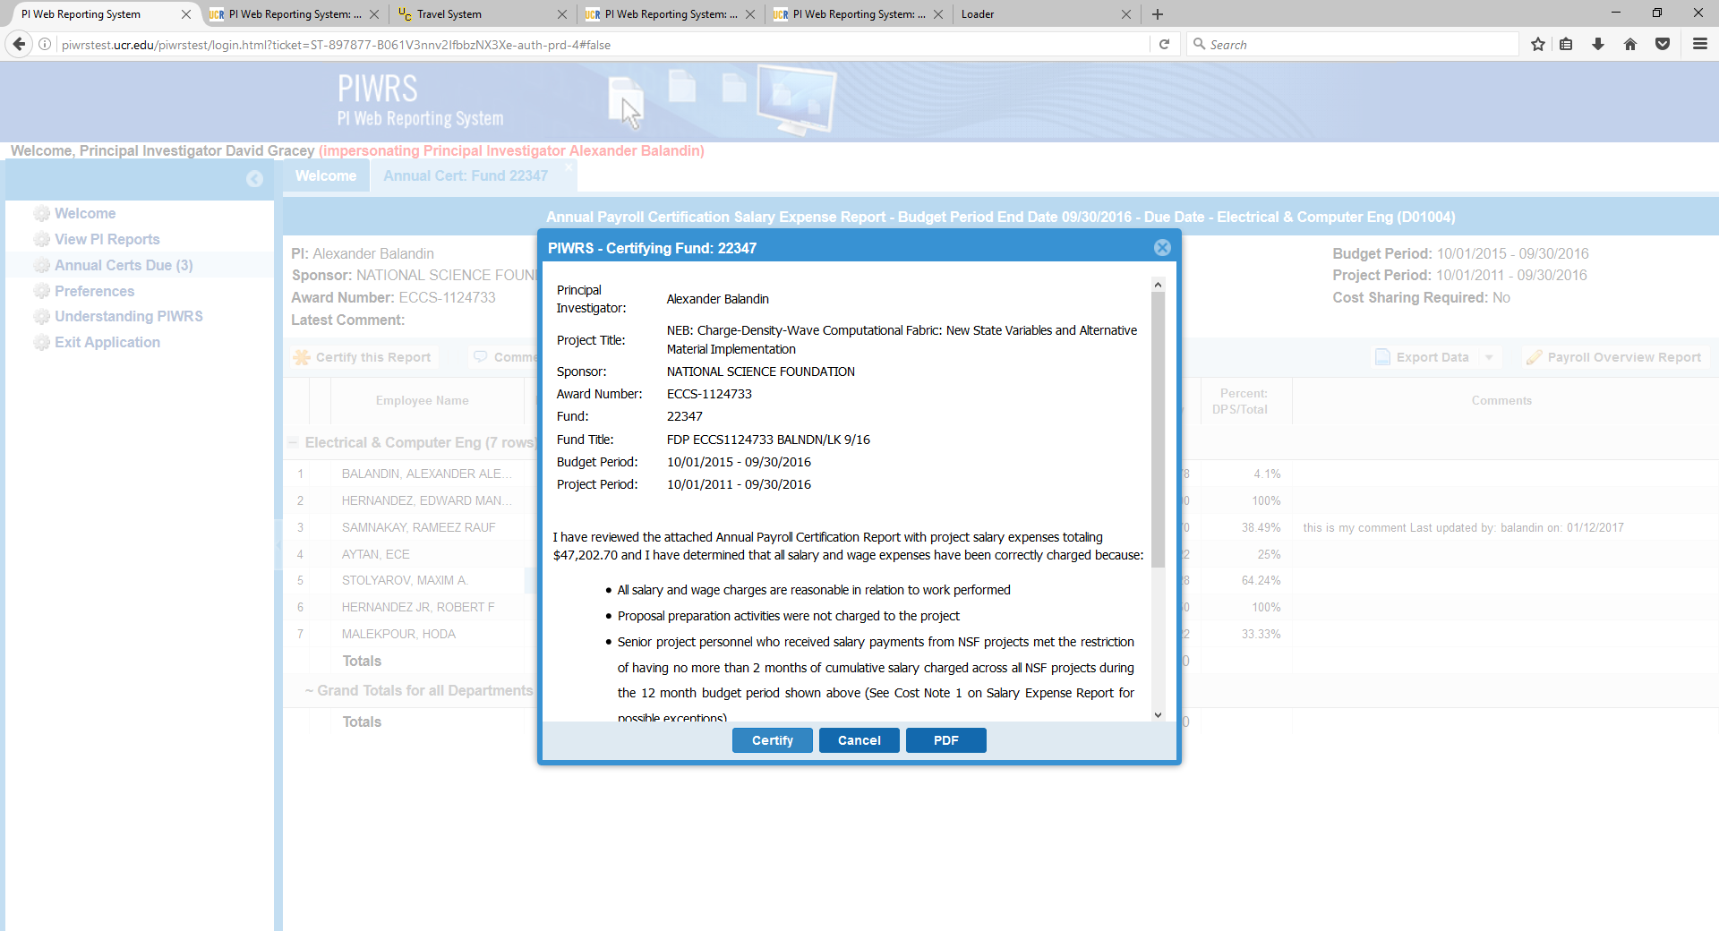
Notes:
This is the certification screen presented to the PI when he/she is ready to complete the certification. The first two bulleted statements appear on every payroll certification. Additional certification statement are presented based on Cost Notes appearing on the payroll details screen. Additional information on Cost Notes is available on the Payroll Certification support site (link provided under the Resource section at the end of this presentation)

Slide 20
PIWRS Demo

Slide 21
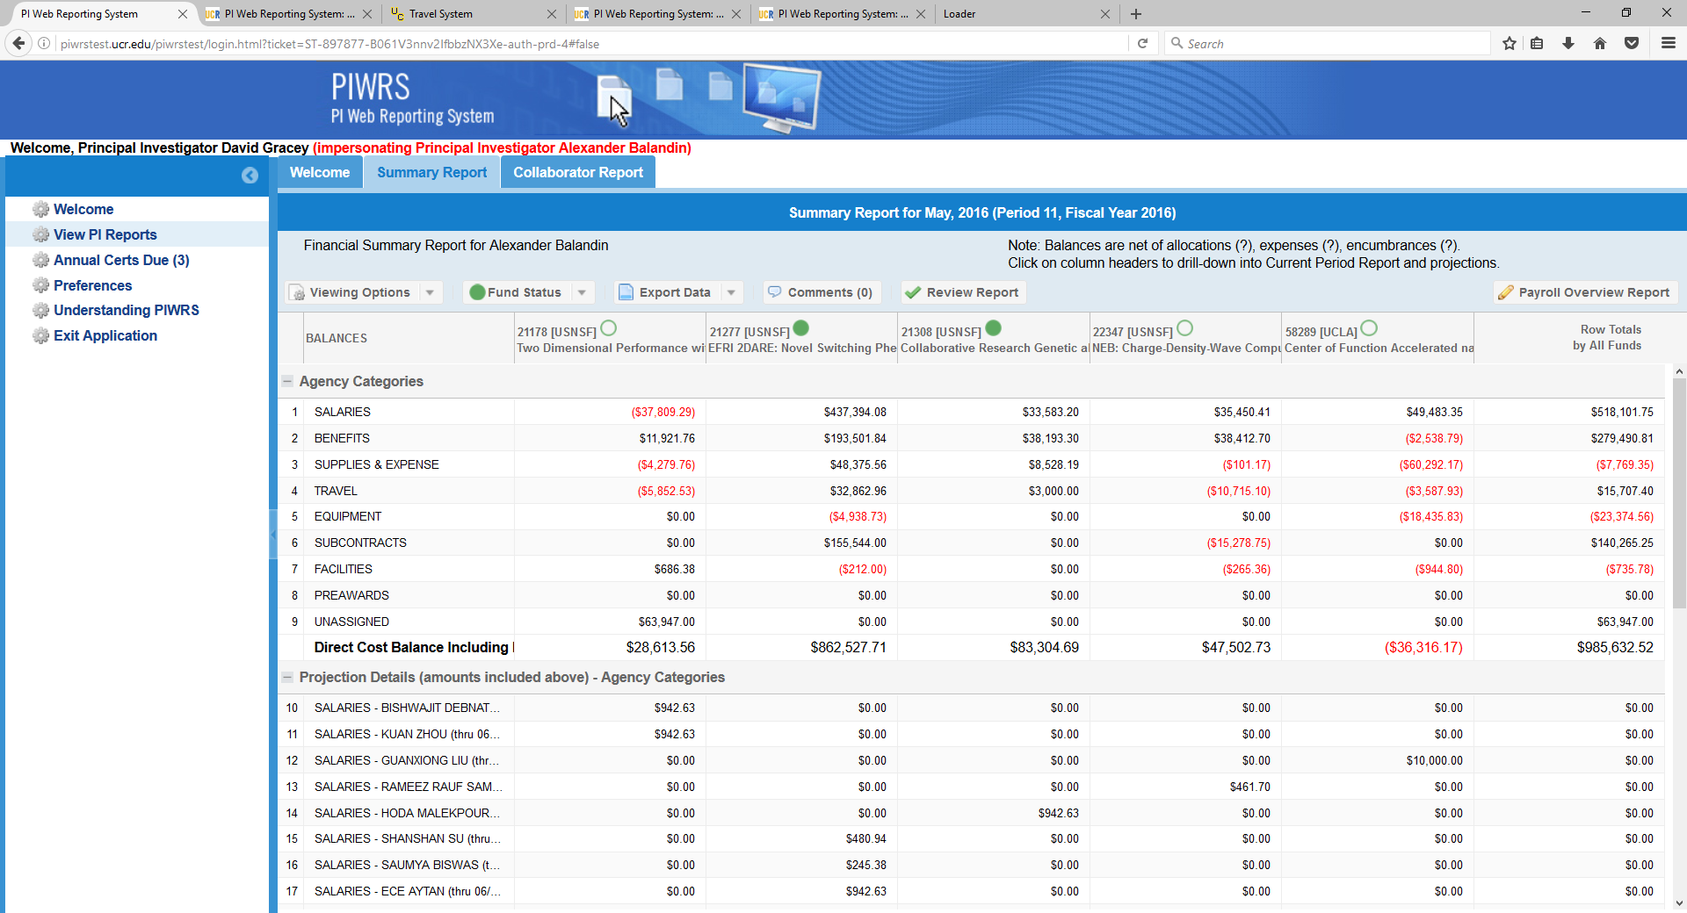
Notes:
The Principal Investigator Web Reporting System (PIWRS) is a report that is automatically generated each month and presented to the Prime PI. The reports show all contract and grant funds associated with the PI for the given period. There are various options to view information (e.g. budget, expense, balances); the view above is the “balance” view. The review of monthly reports by the PI is recommended and complements the annual payroll certification process. Note: these reports are made available to department analysts to review and modify projections in advance of distributing to the PI. Department analyst also have the ability to add information related to non-contract and grant funds to allow for the presentment of all the PI’s resources in one location.

Slide 22
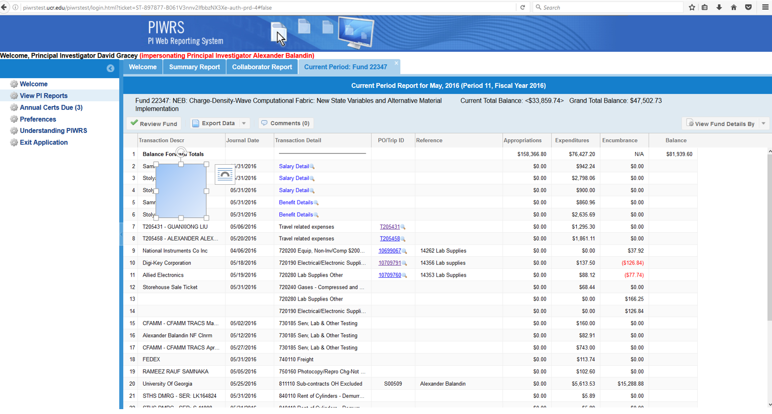
Notes:
When drilling into a funds details, the PI is presented with a list of all expenditures for the specific month.

Slide 23
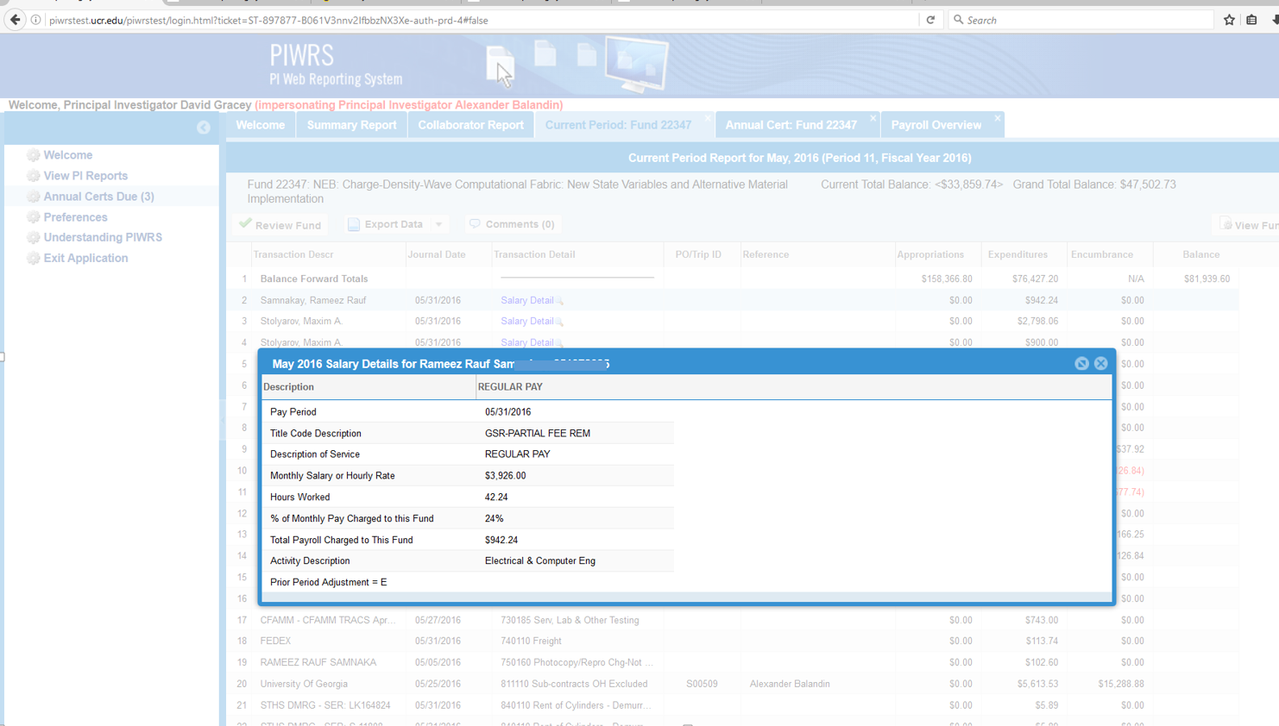
Notes:
Our monthly PIWRS system has the ability for PI’s to drill into salary and other details of expenditures; this example is a drilldown into an individual employee paid on the PI’s award

Slide 24
Monitoring Reports Demo

Slide 25
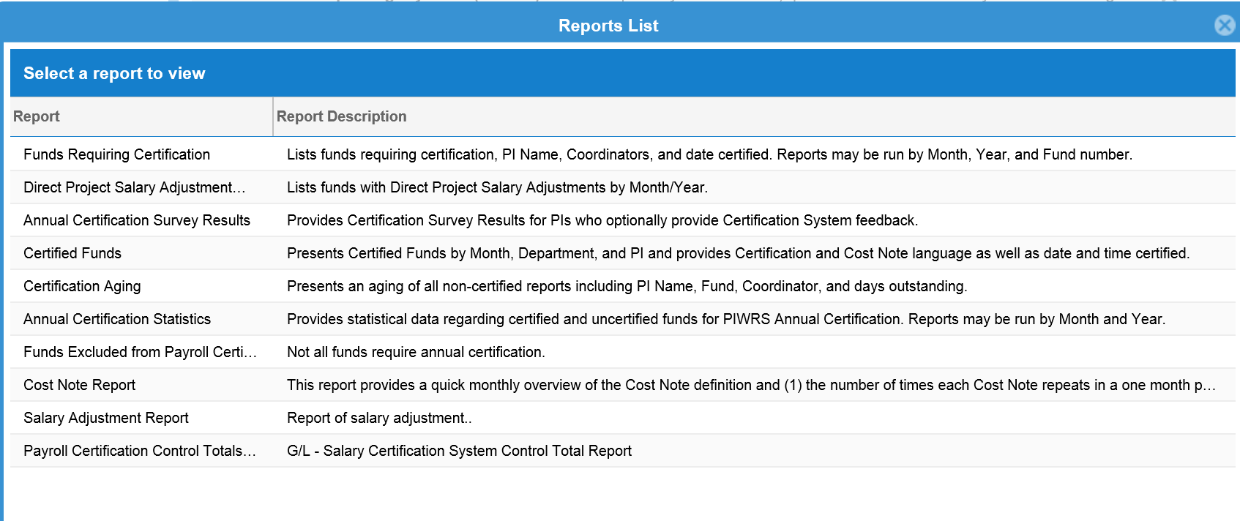
Notes:
This is a listing of the administrative reports that are available to the Central Office to monitor certifications

Slide 26
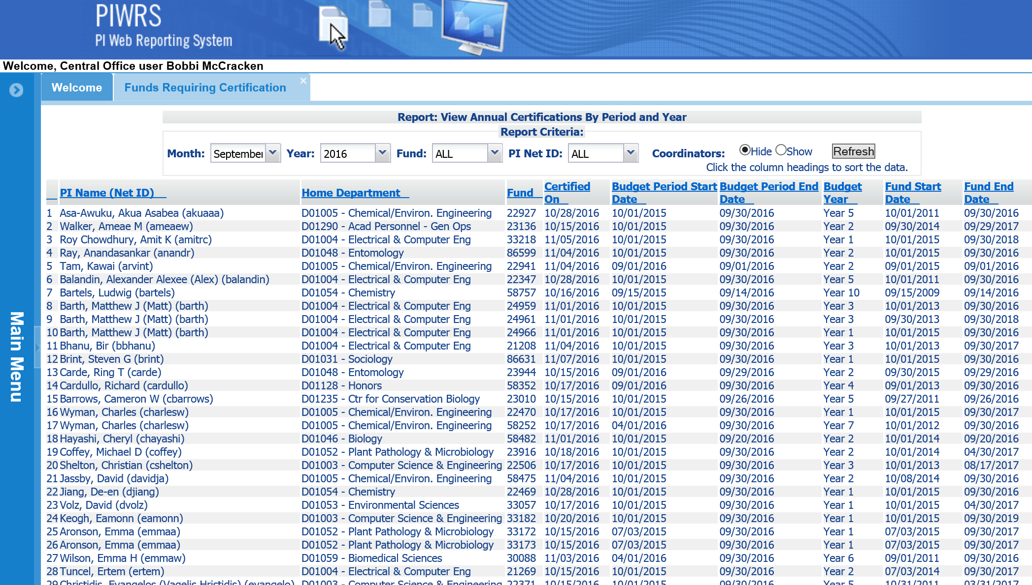
Notes:
Note this is the test environment

Slide 27
Questions?

Slide 28
Supplemental Info

Slide 29
Reference Material
Federal Demonstration Partnership White Paper for Payroll Certification Proposal:
http://sites.nationalacademies.org/cs/groups/pgasite/documents/webpage/pga_055994.pdf
UCR Payroll Certification Support Site:
http://cnc.ucr.edu/piwrs/salary.html
UCR Policy 200-40:
http://fboapps.ucr.edu/policies/index.php?path=viewPolicies.php&policy=200-40

