Slide 1
ERS v11.0 is live at UCLA on May 21, 2018
Supports UCPath and PPS Earnings
Presented by
Faye Isaacson
May 23, 2018

Slide 2
Agenda
Overview
Starting May 21, 2018 these changes are visible in ERS version 11.0
Payroll Detail Hybrid report headings
Correction to Late Pay bugs
Enhancement for processing unrecognized earnings
Starting ~October 1, 2018 these changes will be visible when UCPath goes live and the new interface I-129 loads earnings into ERS
Q&A
Notes:
a

Slide 3
Overview
ERS version 11.0 works with earnings from either UCPath or PPS
Fundamentally the same system
No changes to calculations – Percentage of effort is the same
Effort Reports are the same, Certification is the same
The major difference – Earnings from UCPath are different from PPS earnings
Differences are visible in the Payroll Detail Report
Extras - Version 11.0 includes 3 bug fixes and
1 enhancement for late pay transactions
Timing
5/21/18 – ERS version 11.0 is up and running at UCLA
10/1/18 – UCPath goes live, UCPath earnings begin

Slide 4
Immediate Changes in ERS visible May 21, 2018
Payroll Detail Hybrid report headings
Examples of Payroll Detail Report
Correction to Late Pay bugs
Enhancement for processing unrecognized earnings
Notes:
a

Slide 5
Payroll Detail Report with
new hybrid (PPS and UCPath) Headings
ERS 10.12 Previous version Headers / Columns | ERS 11.0 New version Headers / Columns
Pay Period | Pay Period
Pay Cycle Code | Pay Cycle Code
FAU | FAU
DOS Code | Earn / DOS
Trans Code | Restate / Trans
Title Code | Job / Title
Pay Rate | Comp / Pay Rate
Rate Type | Basis / Type
 | Pay Amount
Paid % | Paid %
Derived % | Derived Effort %
Weighted % | Weighted Effort %
 | OTC Ind
Pay Category | Pay Cat
Time Code | Time Code
Pay Cycle End Date | Pay Cycle End Date
Notes:
a

Slide 6
Payroll Detail Report with
new hybrid (PPS and UCPath) Headings
ERS 11.0
New
New
ERS 10.12 and previous
Notes:
a

Slide 7
Payroll Detail Report with
Hybrid (PPS and UCPath) Rollover Headings
Notes:
a

Slide 8
Correction to Late Pay Bugs
Correction #1 for processing unrecognized earnings:
(Ticket EBE-90) Unrecognized earnings were cleared and the status changed to Open even though all the lines were certified
Added to ERS 11.0 as new requirement
In the case of an unrecognized earning and a previously certified effort report: If the unrecognized earning becomes recognized (because the matching FAU has been added to the FS table) and is applied by ERS below the line as an ‘excluded’ earning (not effort bearing), there should be no change to the certification – i.e., the report should stay certified.
(Previously existing requirements)
If the earning becomes recognized and the newly recognized earning is applied ‘above the line’, the report should remain certified as long as the earning applied keeps the report within a 1% tolerance. The report should reissue as long as there is more than a 1% change when the earning is applied.
Notes:
a

Slide 9
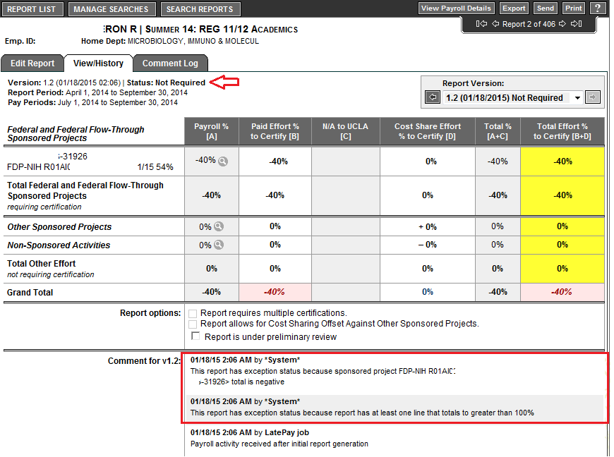
Correction to Late Pay Bugs (Cont.)
Correction #2 – Set status to ‘Exception’ when percentage is negative
(Ticket EBE-95) Negative Percent due to an overpayment credit on a federal project
ERS had incorrectly assigned a status of ‘Not Required’ to an effort report.

Slide 10
Correction to Late Pay Bugs (Cont.)
Correction #3 – Eliminated erroneous ‘re-issued’ status on certified report with multiple certifications after late pay
(Ticket EBE-110) Late pay changed report status to Re-issued but all lines are still certified (line-certification)
Issue: After late pay, ERS correctly kept the project lines certified, but incorrectly ‘re-issued’ the report.
After the coding correction was applied, ERS now recognizes all lines are certified and retains the effort report status (same status as prior to late pay processing)
Note: The programming correction for EBE-110 is believed to also have satisfied UCLA’s requested enhancement, EBE-92.
(Ticket EBE-92) Leave the report status at ‘Certified/AdjustReqd’ after a “late pay” job, when the percentages do not change

Slide 11
Enhancement for processing
Unrecognized Earnings
Optional feature in the ERS 11.0 Configuration File
ERS receives ‘earnings’ records from the PPS payroll system. ERS labels an earning ‘unrecognized’ if the FAU in the earning record does not exist in the ERSFundingSource table. This can happen 2 ways:
The Funding Source table (FS interface) is loaded to ERS at a different time than earnings are loaded
The PPS payroll system does not edit for FAUs and an erroneous FAU may be caused by a ‘fat finger’ entry
Currently, when effort reports are built (at the beginning of the ERS report certification period) all earnings are categorized into one of the following categories; sponsored projects (effort requiring certification), other sponsored projects, non-sponsored activities, and unrecognized earnings. When an unrecognized earning is encountered, it must be cleaned up (ie earning removed or funding source created) and the effort report rebuilt.
This new optional feature gives the campuses the option to stop unrecognized earnings becoming part of an effort report. When the PAR interface receives earnings records from PPS, it will check for an unrecognized earnings. If an unrecognized earning is received, it will tag earning record as ‘unrecognized’ and send an email notification to the campus ERS administrator (as defined in the ERS config file). The unrecognized earning will ‘sit’ in the ERSEarnings table until a ERSFundingSource record (with matching FAU) is found.
Additionally, a ‘lag days’ column will be added to the ERS Config file. This will prevent the unrecognized earning being reported to the campus for ‘X’ days, giving a new FAU time to reach the ERSFoundingSource table. When the FAU reaches the ERSFundingSource table, the unrecognized earning will be released. The earning will then be either picked-up in the next ERS build cycle or processed by the ERS LatePay job.
Notes:
a

Slide 12
Enhancement for processing
Unrecognized Earnings
There are options to send notification emails either immediately or after aging them a number of lag days.
This new optional enhancement should be tested before turning it ‘on’.
Notes:
a

Slide 13
Changes when UCPath goes live ~Oct 1, 2018
and new interface I-129 loads earnings into ERS
DATA IS DIFFERENT FROM UCPATH
PPS DOS Codes vs UCPath Earnings Codes
PPS Transaction Codes do not exist in UCPath - UCPath Salary Cost Transfers
How vacation, sick, jury duty, military pay, etc. is paid in UCPath
(Major Change) Employee Reduction in Time (ERT) and Phased Retirement (RPT) will not come over to ERS and will not be associated with an FAU
UCPATH edits FAUs – FAUs with issues will contain a literal
Salary Cap
Biweekly earnings when pay period spans 2 months
PPS earnings are limited to $99,999.99. UCPath earnings have no size constraints
How to search by Home Department
Notes:
a

Slide 14
PPS DOS Codes vs. UCPath Earnings Codes
DOS Code to Earn Code is not always a 1-to-1 conversion
‘Retro’ Earn Codes begin with ‘9’.
From UCPath Master Earn Code List – last updated 5/14/18
DOS Code | Earn Code | Retro Earn Code | Earn Code Description
REG | REG | 9RG | Regular Pay
SKL | SKL | 9SK | Sick Leave Paid - Salary
SKL | S1L | 9SL | Sick Leave Paid - Hourly
VAC | VAC | 9VC | Vacation Leave - Used Salaried
VAC | VCN | 9VN | Vacation Leave - Used Hourly
JUR | JUR | 9JR | Jury Duty - Salaried
JUR | JRN | 9JN | Jury Duty - Hourly
OTS | OTS | 9OS | Overtime Pay - Straight
OTP | OTP | 9OP | Overtime Pay - Premium
SDM / NSD | NSD | 9NS | Night Shift Differential
CPC / CPG | CRT | 952 | Certification Pay
PDD | SPD | 980 | Stipend-Post Doc
Notes:
a

Slide 15
PPS DOS Codes vs. UCPath Earnings Codes
Off-Quarter DOS Codes, Earn Codes, and Retro Earn Codes must be maintained up-to-date in the ERS DOS Code Table
From UCPath Master Earn Code List – last updated 5/14/18
DOS Codes | Primary Earn Code | Retro Earn Code | Long Description (30 Char)
ACA, APA | ACA | 9AC | Additional Comp-Admin
AMN, AFN | ACN | 9CN | Additional Comp-Gen-No RTMT
ACR, AAC, ARC | ACR | 9CC | Additional Comp-Research
SSG, SSC, SMR | ACS | 9CS | Additional Comp-Summer Session-DCP
ACT, ACS | ACT | 9TC | Additional Comp-Teaching
ACM, ACF | ADC | 9DC | Additional Comp-General
AFR | AFR | 9AF | Additional Comp-FY Research
Is this Off QTR?
UCLA’s current Off-Quarter codes
in the ERS DOS Code Table
Code | Period_Type
AAC | O
ACA | O
ACM | O
ACR | O
ACS | O
ACT | O
APA | O
ARC | O
SSC | O
9AC | O
9CC | O
9TC | O
It appears the following Earn Codes and Retro Earn Codes need to be added to UCLA’s DOS Code table
For ACM: Add ADC, 9DC
For SSC: Add 9CS
Notes:
a

Slide 16
PPS Transaction Codes will not exist in UCPath
PPS Transaction Code |  | Equivalent in UCPath? | Restatement Flag Identifies Salary Cost Transfers
AP | Additional pay | Retro Earn Code | N= Normal
AU | Automatic pay | No | N
C2 | Cancellation | No | N
E1 | Expense transfer 1 | Only as Restatement Flag | R – (Reversal from Prior FAU)
E3 | Expense transfer 3 | Only as Restatement Flag | Y – (Restatement to Correct FAU)
FT | One-time payment | No | N
H2 | Hand-Drawn | No | N
LX | Late time or leave | No | N
O2 | Overpayment | No | N
RA | Retroactive pay | No | N
RX | Reduction in pay or leave | No | N
R2 | Rush Check | No | N
ST | Payment in lieu of notice | No | N
TE | Exception time | No | N
TX | Positive time | No | N
Most Transaction Codes are not needed as the information is inherent in the UCPath Earnings Code
Roughly equivalent – ‘E1’ / ’E3’ and Salary Cost Transfers
Replaced by Restatement Flag in UCPath
R (Reversal) is equivalent to E1
Y (Restatement) is equivalent to E3
Roughly equivalent - Transaction Code ‘AP’ (Additional Pay) Additional pay amount will be represented by Retro Earn Codes like 9RG
Notes:
a

Slide 17
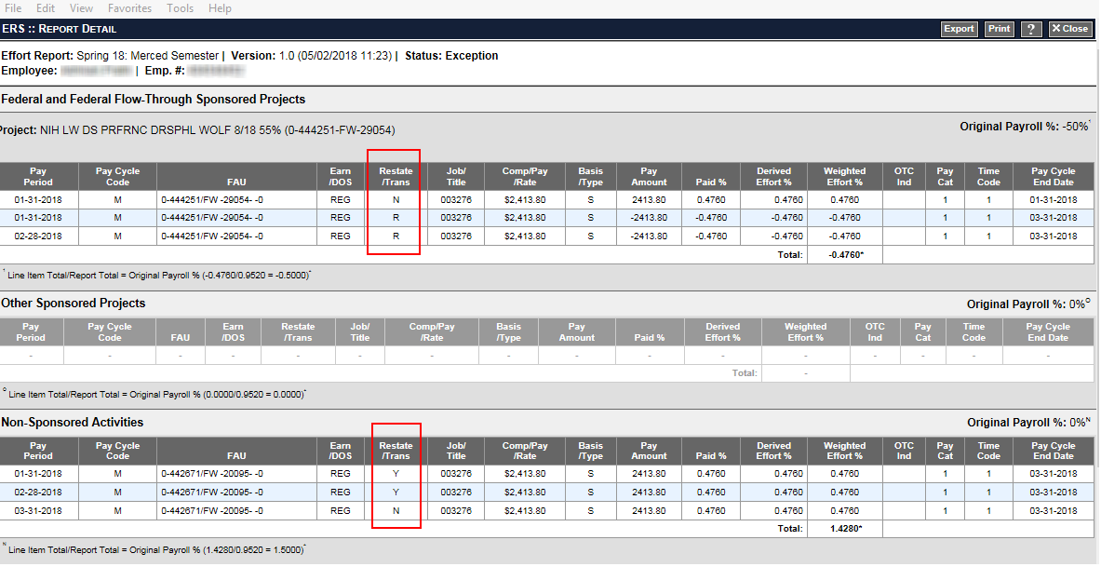
UCPath Salary Cost Transfer
Example of UCPath Salary Cost Transfers
Restatement Flag ‘R’ reverses the 1/31/18 and 2/28/18 earnings
Restatement Flag ‘Y’ restates the earnings to a different FAU
Restatement Flag ‘N’ indicates transaction is not a SCT
Notes:
a

Slide 18
How Vacation, Sick, Jury Duty, Military Pay, etc.,
Is paid in UCPath
This is the Payroll Register Report from the PeopleSoft (UCPath) Payroll system
Regular pay is reduced and vacation, sick, etc., earnings are paid
LNF is a new Earn code – Leave-No Pay-FMLA Salaried
Notes:
a

Slide 19
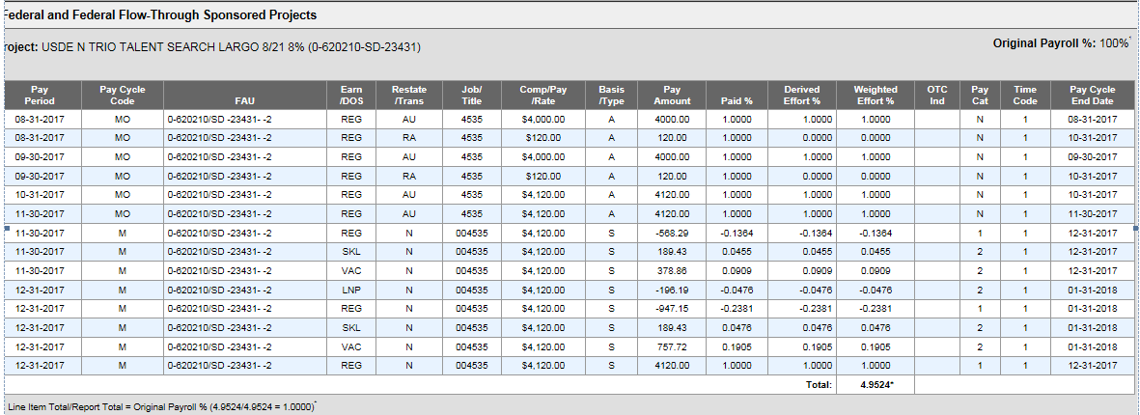
How Vacation, Sick, Jury Duty, Military Pay, etc.,
Is paid in UCPath
UCPath Sick and Vacation earnings in ERS 11.0 will go ‘Above the Line’
PPS Sick and Vacation earnings in ERS 11.0 continue to go ‘Below the Line’
Notes:
a

Slide 20
(Major Change) ERT and RPT Earn Codes
will not come over to ERS and do not have a FAU
Employee Reduction of Time (ERT)
Phased Retirement (RPT)
These Earn Codes do not add to gross in UCPath
These earnings are netted with REG in UCPath so ERS will not receive ERT or RPT Earn Codes
The ERT and RPT Earn Codes are not associated with a FAU
ERT and RPT are visible in the UCPath Payroll Register Report and can be queried from DDODS
Notes:
a

Slide 21
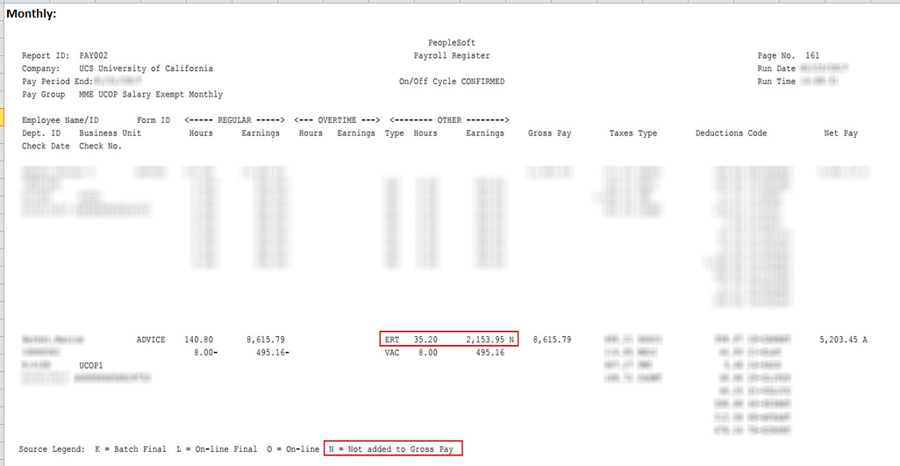
(Major Change) ERT and RPT Earn Codes
will not come over to ERS and do not have a FAU
ERIT (ERT) does not add to gross
Notes:
a

Slide 22
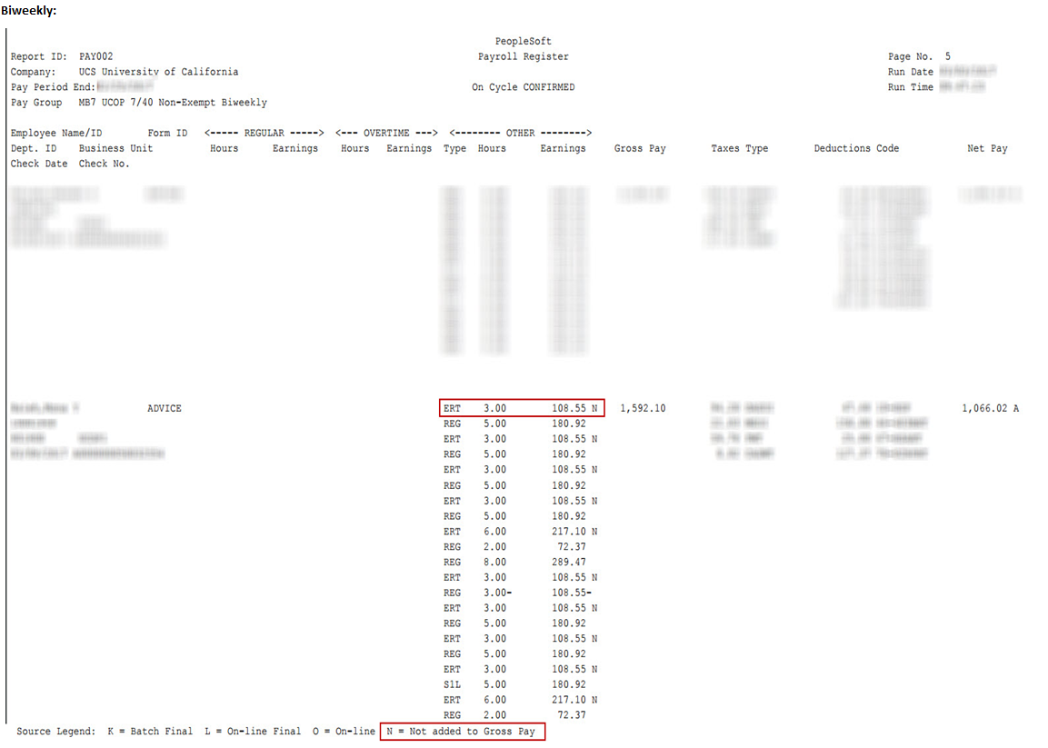
(Major Change) ERT and RPT Earn Codes
will not come over to ERS and do not have a FAU
ERIT (ERT) does not add to gross
Notes:
a

Slide 23
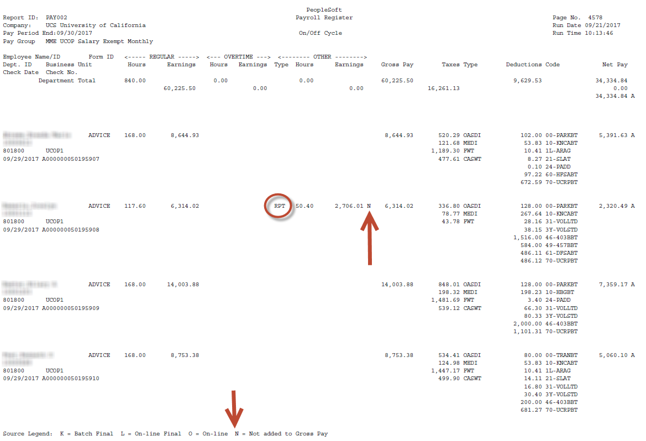
(Major Change) ERT and RPT Earn Codes
will not come over to ERS and do not have a FAU
Phased Retirement (RPT) does not add to gross
Notes:
a

Slide 24
UCPath edits FAUs – FAUs with issues will contain a Literal
If UCPath encounters errors when attempting to charge/use FAUs, it identifies the issue by placing a literal in the Project Code Chart field. Note: Other campuses may place the literal in a different chart field.
Org/Depts. will leverage the General Liability Redirect Accounts to monitor incorrect funding charges:
Org/Depts. will be provided 3 Default/Suspense account defaults, identified by Project Code.
FUNDNG
ENDDTE
COMBO
Org/Depts. will utilize Payroll reports to identify charges to their Suspense Account.
Org/Depts. will manage all charges to their Suspense Accounts, i.e., make funding changes and/or Salary Cost Transfers when necessary.
Note: UCPath will be using the same General Liability Redirect account that each department has today.
The Project field will be leveraged to identify the issue.
The 3 types of issues identified by the Project field are:
Department Level Funding: FAU charged when no funding exists at the JED, paysheet (T&A) or position.
GLR Account/CC, Fund and PROJECT CODE = FUNDNG
Suspense Level: FAU charged when no funding exists at the Department Level or Funds Expired.
GLR Account/CC, Fund and PROJECT CODE = ENDDTE
Edit Error: FAU charged when a combination code (FAU) is determined to be invalid at time of compute/confirm.
GLR Account/CC, Fund and PROJECT CODE = COMBO
Notes:
a

Slide 25
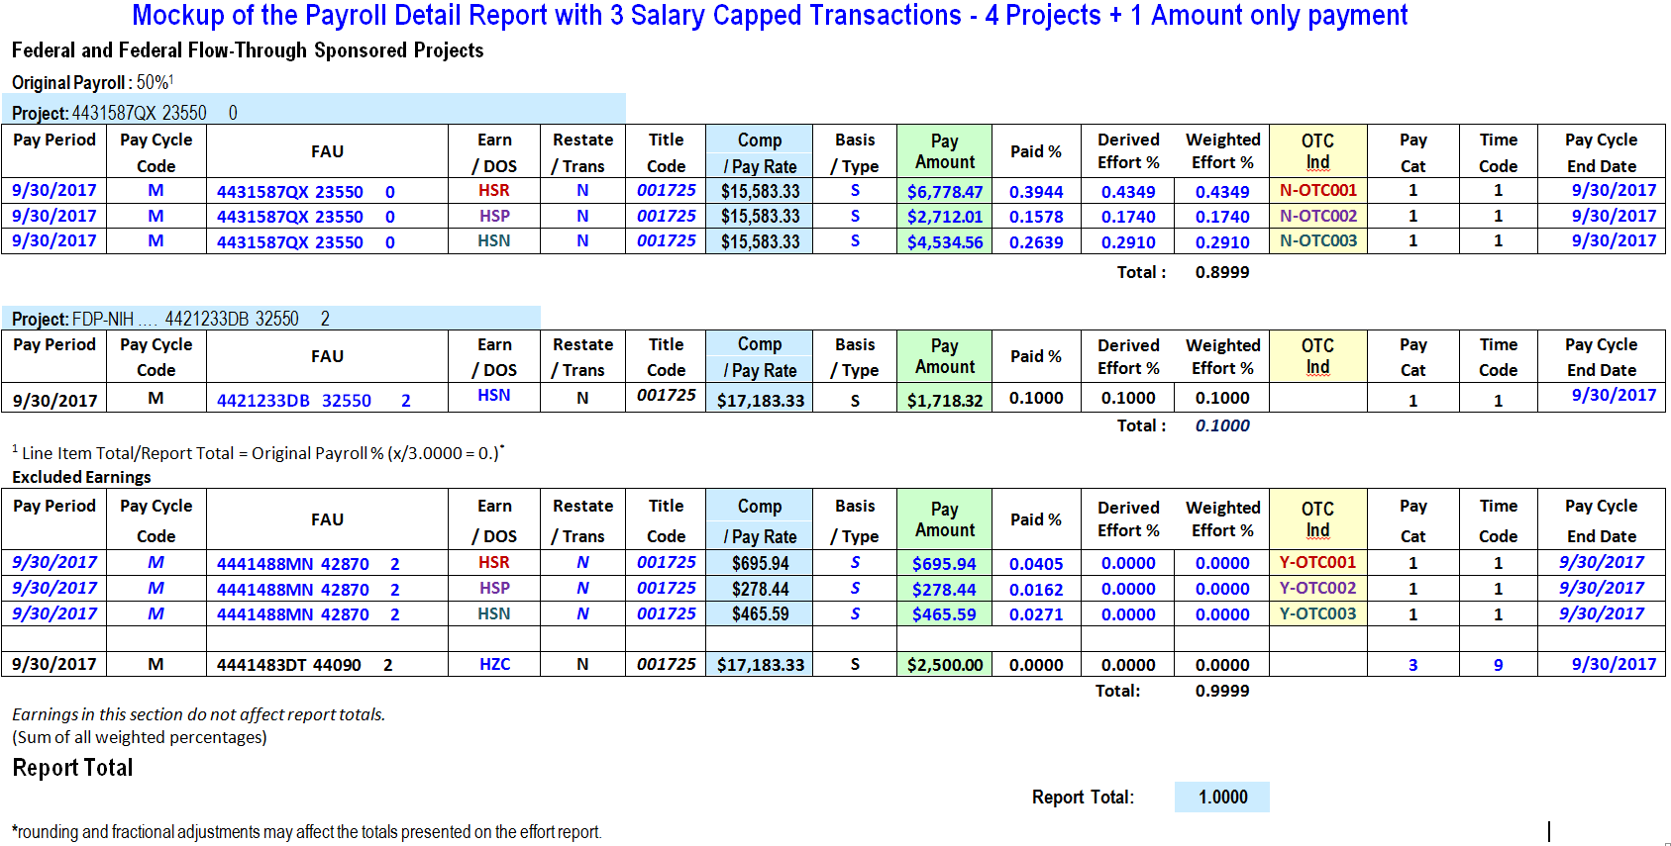
Salary Cap with I-129 Data
NOTE: At this time, UCPath’s handling of vacation earnings when an employee’s earnings exceed the salary cap is still being worked out.
The change is expected to be tested and in place for the Oct 1, 2018 go live
3
5
1
4
6
2
1 and 2 – Over-the-cap Indicator is populated only if earnings have exceed the salary cap
3 – Salary Cap is stated as a monthly amount
4 – Amount over the cap
5 – Derived Effort Percent is the total of all effort #5 and #6
6 – DEP is 0%
Notes:
a

Slide 26
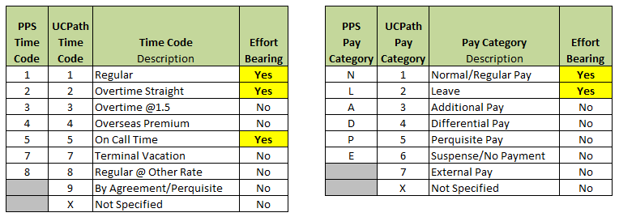
Other Data Differences between PPS and UCPath
Title Code is now ‘Job’ Code. (The UCPath field is larger. It contains the same number value but with 2 leading zeroes)
Pay Rate is now ‘Compensation’.
Pay Cycle Code is now ‘M’ instead of ‘MO’ and 1,2,or 3 instead of B1, B2, B3
Rate Type is now ‘Basis / Paidover’
ERS determines excluded earnings from Time Code and Pay Category
Both Time Code and Pay Category values in the earnings record have to be true (both have to be ‘yes’) for the earning to be effort bearing. If either value is not true, the earning is considered not effort bearing and is reported ‘below the line’ in the Payroll Detail report in the Excluded Earnings section.
Notes:
a

Slide 27
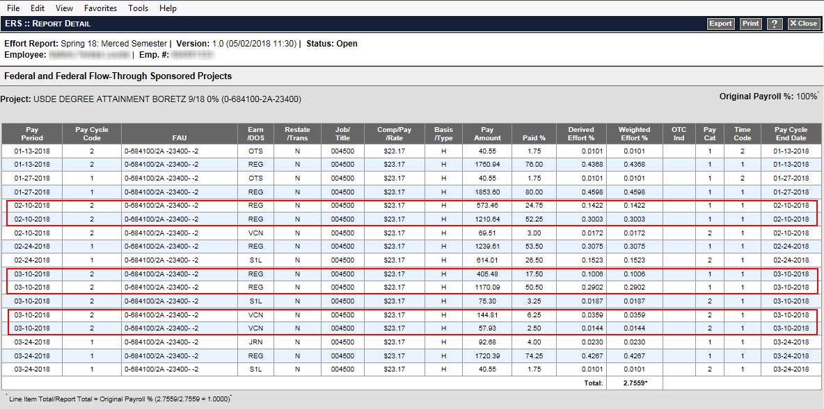
Biweekly Earnings when Pay Period
spans 2 months
Examples of biweekly earnings transactions that span 2 months:
Pay period 1/28/18 - 2/10/18
Pay period 2/25/18 – 3/10/18
1 transaction contains earnings from 1st month, 1 transaction contains earnings from 2nd month
Notes:
a

Slide 28
PPS Earnings are limited to $99,999.99
UCPath has no size constraints
If an employee’s earnings in PPS exceeded this amount PPS would create multiple earnings records
ERS was developed to work with PPS so it also had this earnings constraint
ERS 11.0 has been modified to remove the size constraint in order to process UCPath earnings records of $100,000 or more.
Notes:
a

Slide 29
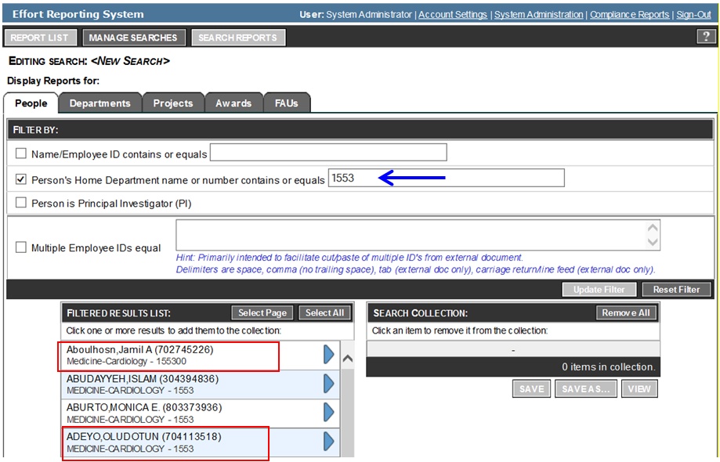
How to Search by Home Department
in ERS version 11.0
In PPS, some locations have used a 4 character HR Home Department field.
In UCPath, the field is 6 characters so 4 character Home Departments will have 2 zeroes added to the end of the value.
For example, ‘1234’ will become ‘123400’. The advantage of adding a suffix of ‘00’ is the current department number(s) will be very recognizable to ERS users.
Notes:
a

Slide 30
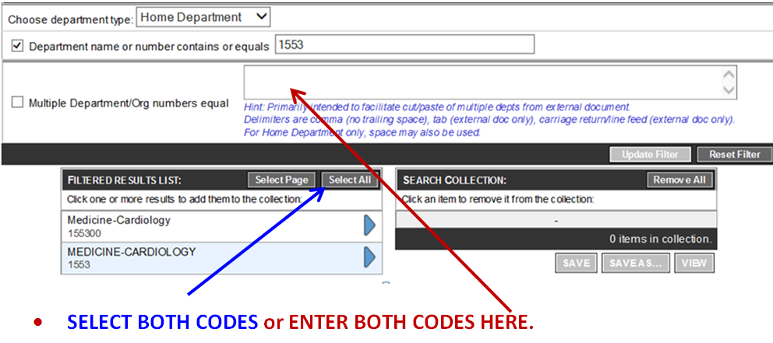
How to Search by Home Department
in ERS version 11.0
In the example below there are 2 Home Departments with the same name: Medicine- Cardiology.
1553 (PPS value) and 155300 (UCPath value with ‘00’ suffix)
Both values represent the same Home Department.
Employees with the 6 character code have had transactions processed by UCPath.
Employees with the 4 character code only have transactions processed by PPS.
To ensure all of the employees in the department are displayed, select both codes in the filter results or enter multiple department codes in the top section.
Notes:
a

Slide 31
Q & A
Notes:
a

